Slide 1
Using LSTM Neural Networks for the Future Valuation of Investments
October 6, 2020
By Zachary M. Wing

Slide 2
Project Introduction
I have Bachelor’s in Digital Design and Computer Science and a Master’s in Data Analytics/Data Science
I also have an interest in Finance
The purpose of this project is to so how the newest techniques in Data Science can be applied to the Finance industry for more accurate predictions for investing
This project will use predictive models on the top 10 invested stocks by capital in a standard mutual fund as an hypothetical investor’s portfolio.
A little background is needed before getting into project specifics

Slide 3
What is a Recurrent Neural Network (RNN)?
RNNs take into consideration the order of the input
RNNs also uses the calculations on the previous nodes to calculate the current node (similar to compound interest)
RNNs can also be programmed with back propagation like other Neural Networks
The following diagram is a simple RNN

Slide 4
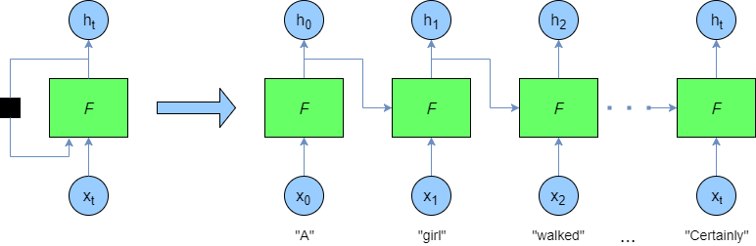
What is a Recurrent Neural Network (RNN)?

Slide 5
So What is Long Short Term Memory (LSTM)?
LSTM is a specific type of RNN
Using backpropagation with RNNs did not work great as RNN tries to track order dependencies, so sometimes when the values were backpropagation, the values would turn to zero or infinity.
LSTM was originally theorized and proposed around 1995-1997
Over the next 10 years it grew and developed on paper but the computing power was not there yet.
In 2009 an LSTM model won a contest in classifying handwriting, finally proving it to be a competitive model
LSTM is now used in Google Voice, Google Allo (translator), Apple Siri, and Amazon Alexa

Slide 6
So What is Long Short Term Memory (LSTM)?
The basic LSTM has 3 gates: an input gate, a forgot gate, and an output gate
The input gate controls the new value going in
The forgot gate controls the value being retained
The output gate controls the value being used in the output activation
The connections between the gates are weights that can be changed during training
The following diagram is a basic LSTM Node

Slide 7
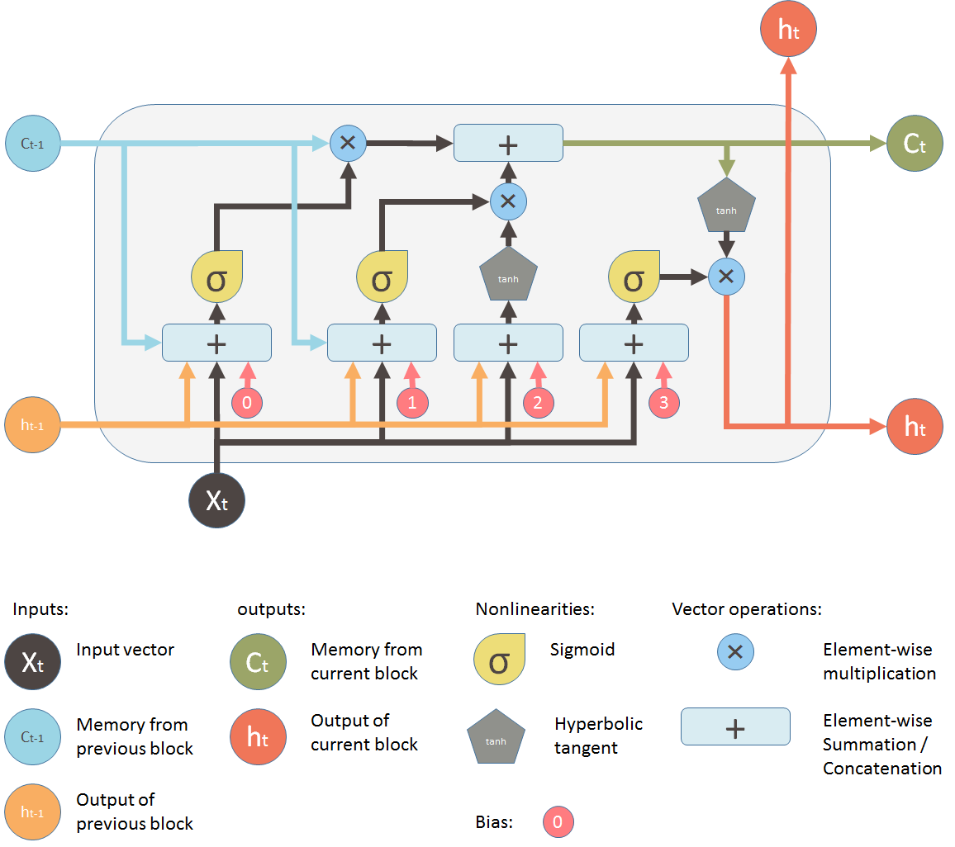
So What is Long Short Term Memory (LSTM)?

Slide 8
Why is LSTM the Future?
There are many methods that financial firms have used in their trading practices
Some still use old calculated values such as volume weighted average or moving average etc.
Some companies have moved toward new machine learning for time series analysis including investment companies
ARIMA, Prophet, and in-house custom analytics are the most popular
The following slides show time series analytics on sample stock market data

Slide 9
Volume Weighted Average (VWAP)
VWAP is one of the most popular calculated measures that is used for trading
It is the weighted average of trades taking into account trade volume (number of shares traded)
If a stock is acting normally traders will trade under two conditions:
If price is under VWAP and increasing (toward VWAP) it is considered a buy.
If price is above VWAP and decreasing (toward VWAP) it is considered a sell.

Slide 10
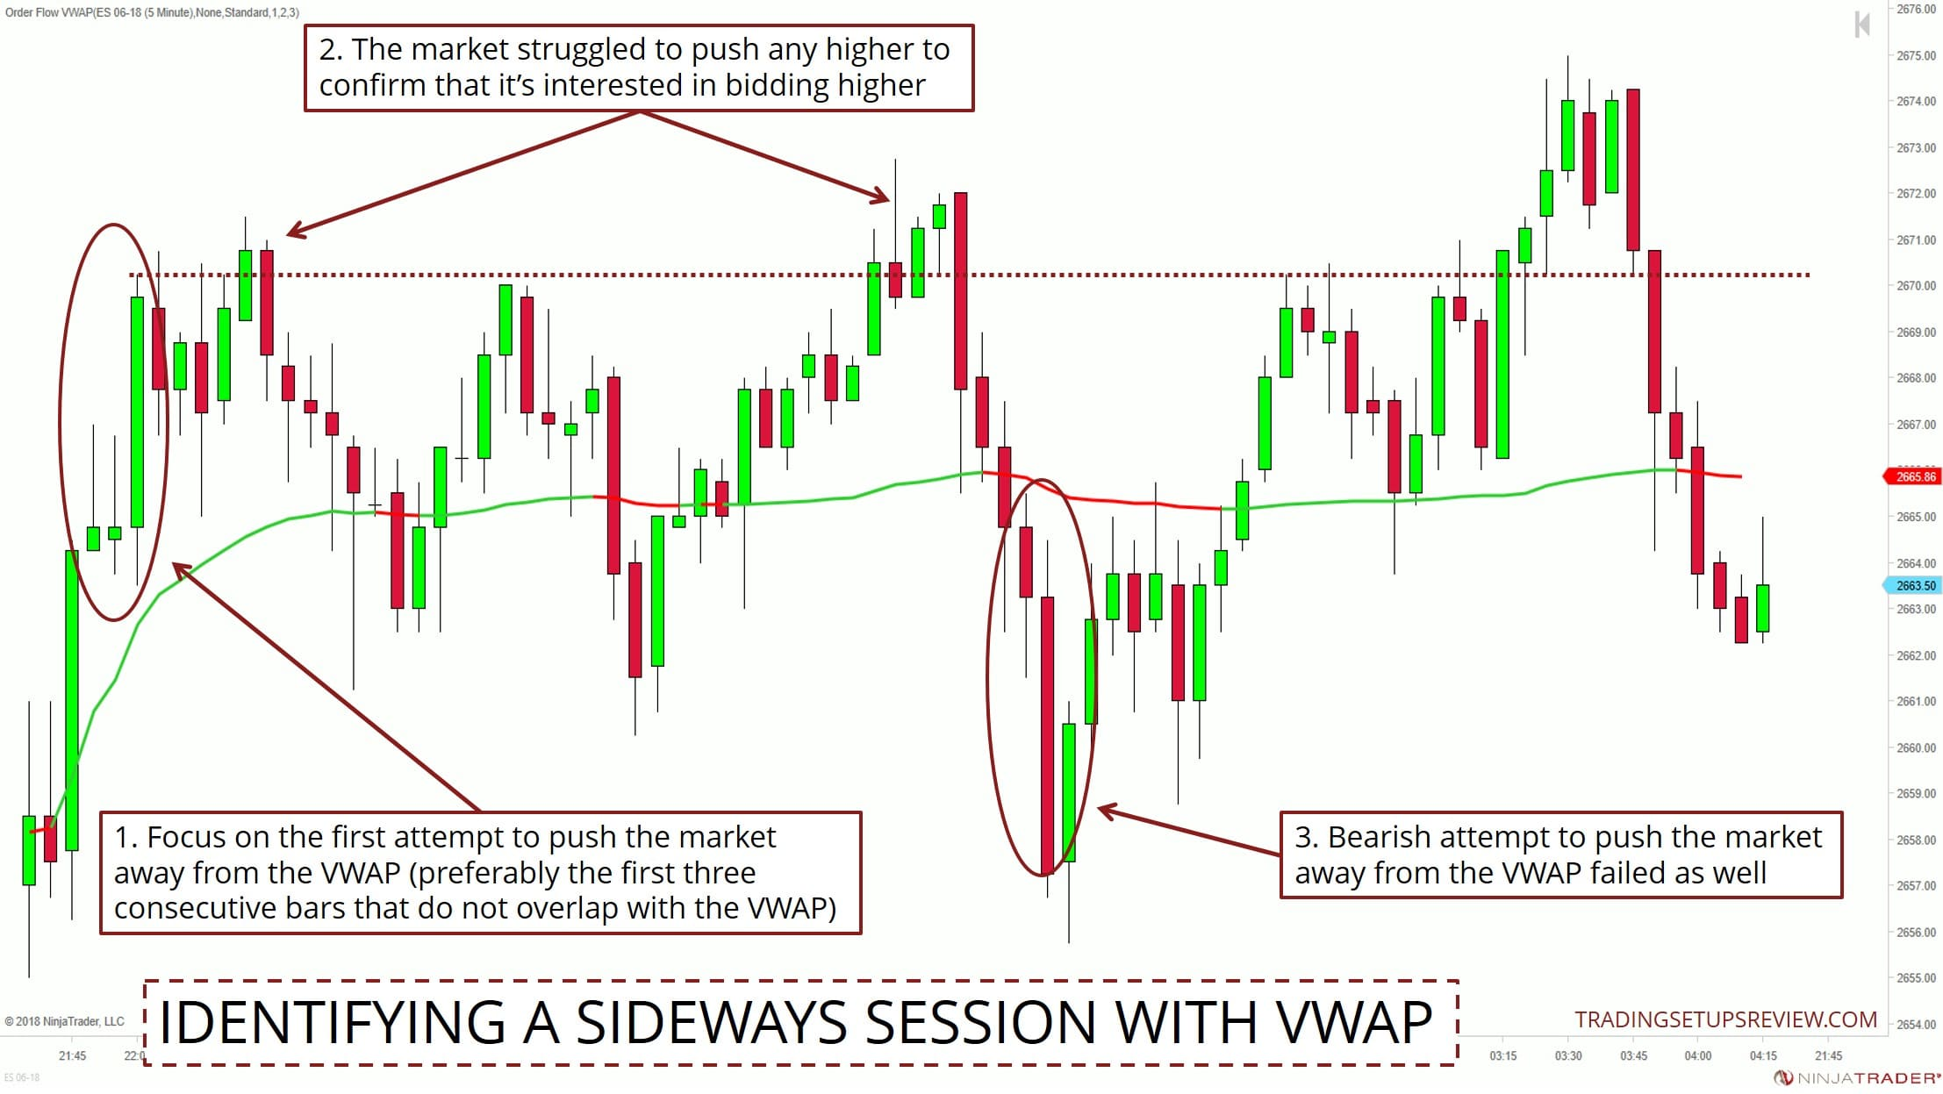
VWAP

Slide 11
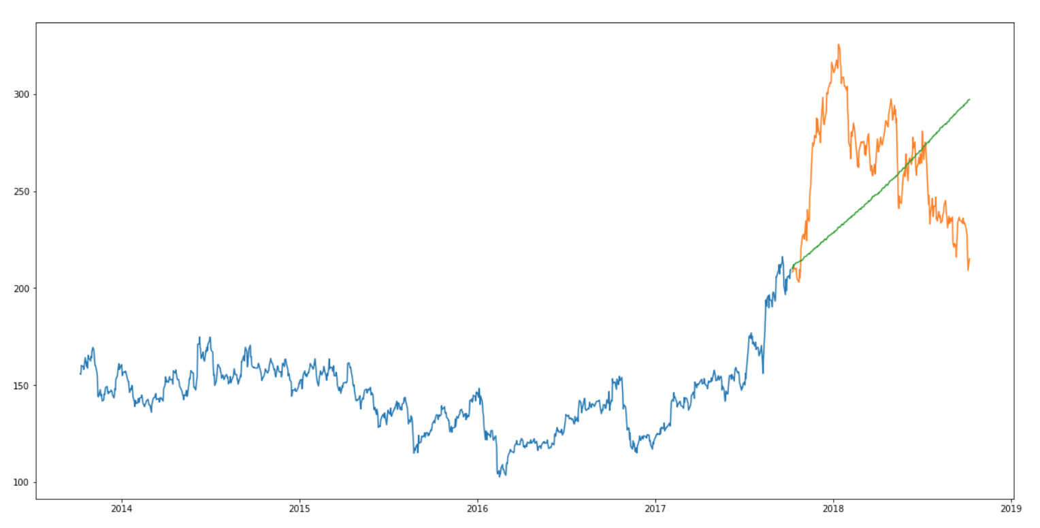
ARIMA

Slide 12
ARIMA
ARIMA uses past data understand patterns
Captured the increasing trend
Does not capture seasonality
Not close to real values

Slide 13
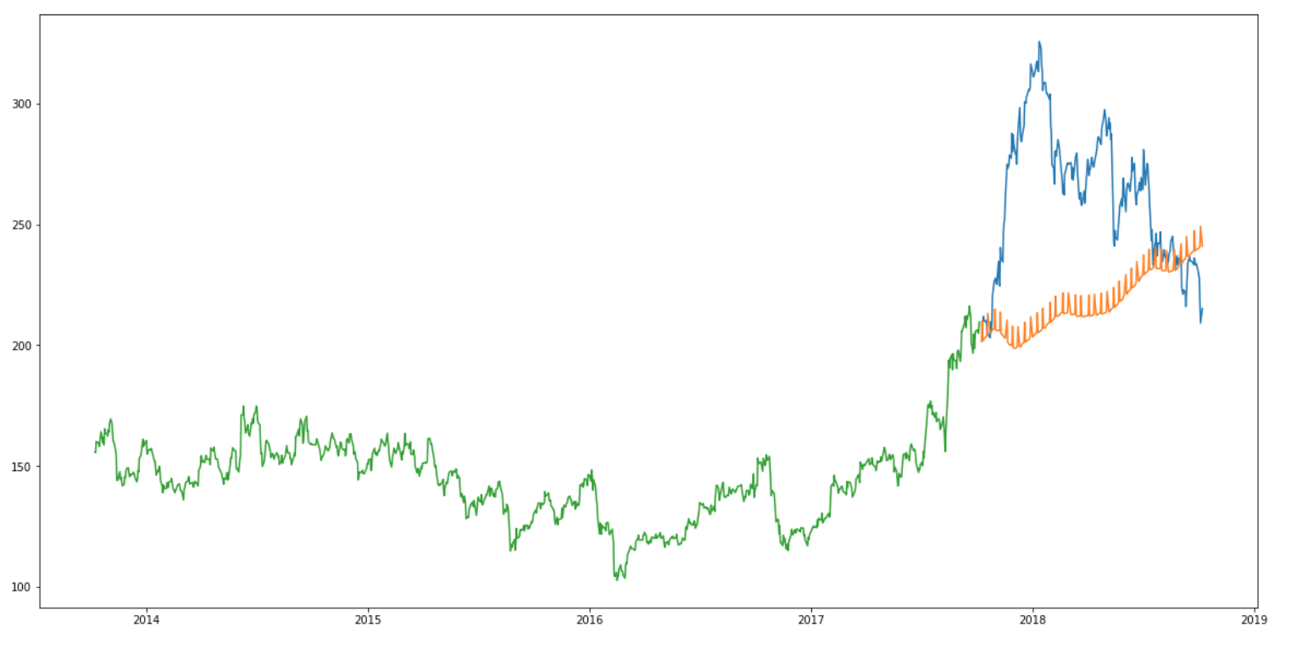
Prophet

Slide 14
Prophet
Prophet was created by Facebook and is open source
Uses past data understand patterns
Captured the increasing trend
Typically Prophet does good capturing trend and seasonality on time series data
In actual case does not work as well on stock market data

Slide 15
Early Steps of the Project
Browsed T. Rowe Price Mutual Funds
Chose Communications and Technology Fund
Downloaded the End of Q2 portfolio holdings
10 largest investments by capital are the 10 used for the project.
Downloaded daily prices from Yahoo Finance under historical data.
Created spreadsheet to display the data of the 10 investments from the pdf
Name, Shares, Value ($), and % of Top 10.

Slide 16
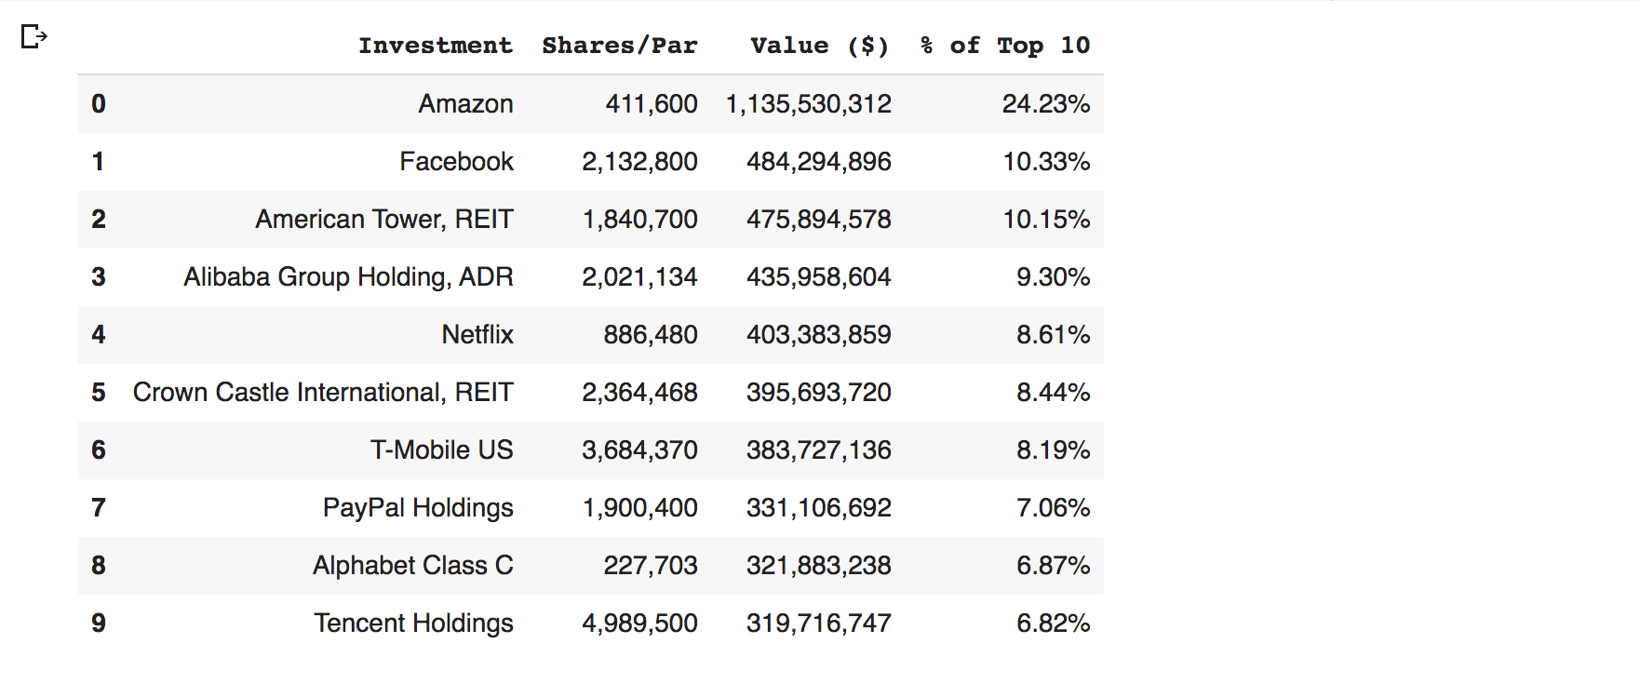
Investments Used

Slide 17
Repeated Steps
The Following Steps were repeated for each Stock
Read Data
Split Data (test data is about a month from the quarter end)
LSTM is trained using the previous 60 days before the end of the quarter
Plot predictions compared to real test data (just for display)
Using predictions find highest price as simulated sell date
Display profit and investment return calculations
Add data to final table

Slide 18
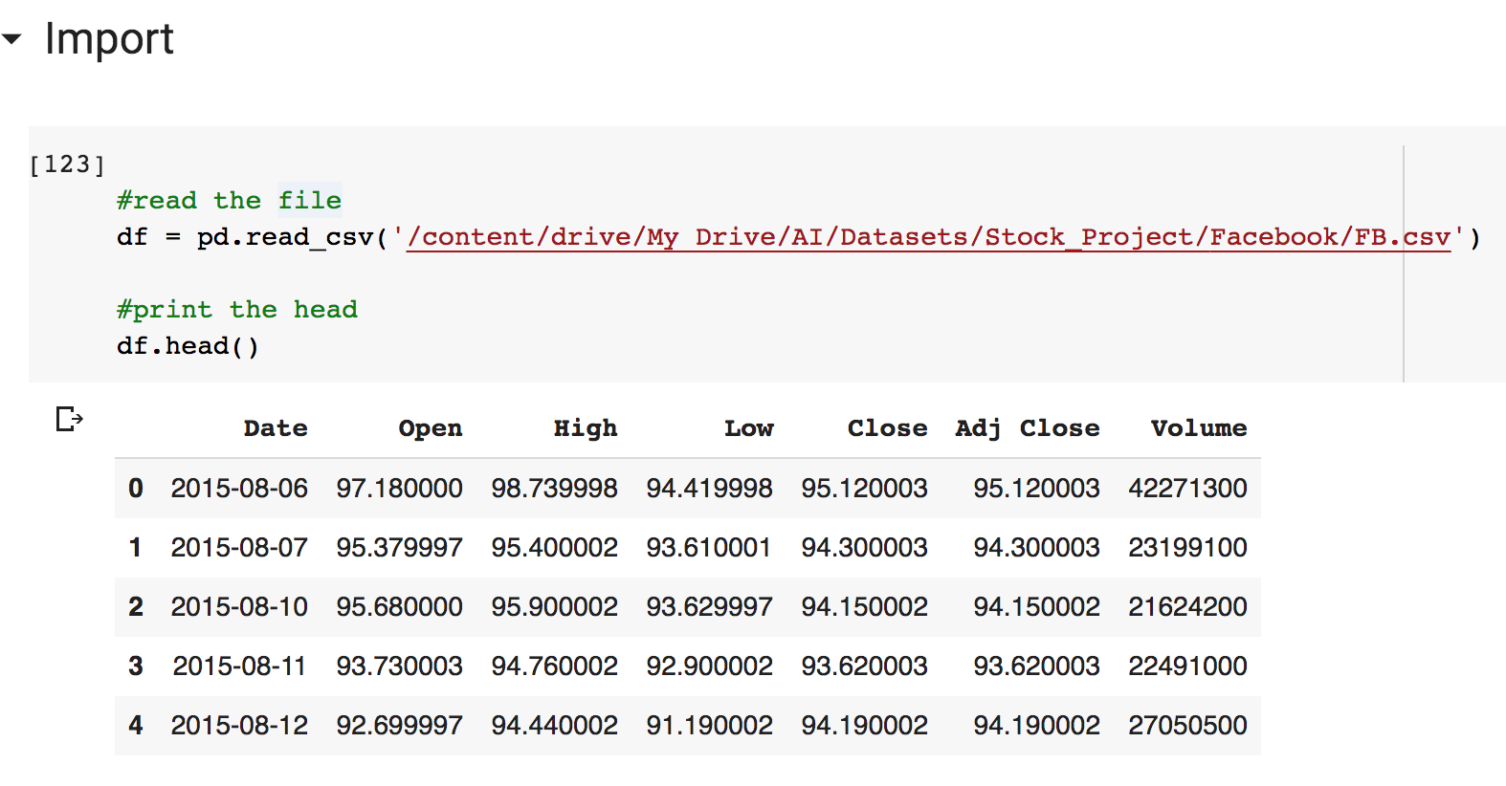
Read Data
Here I am importing the Yahoo historical data.

Slide 19
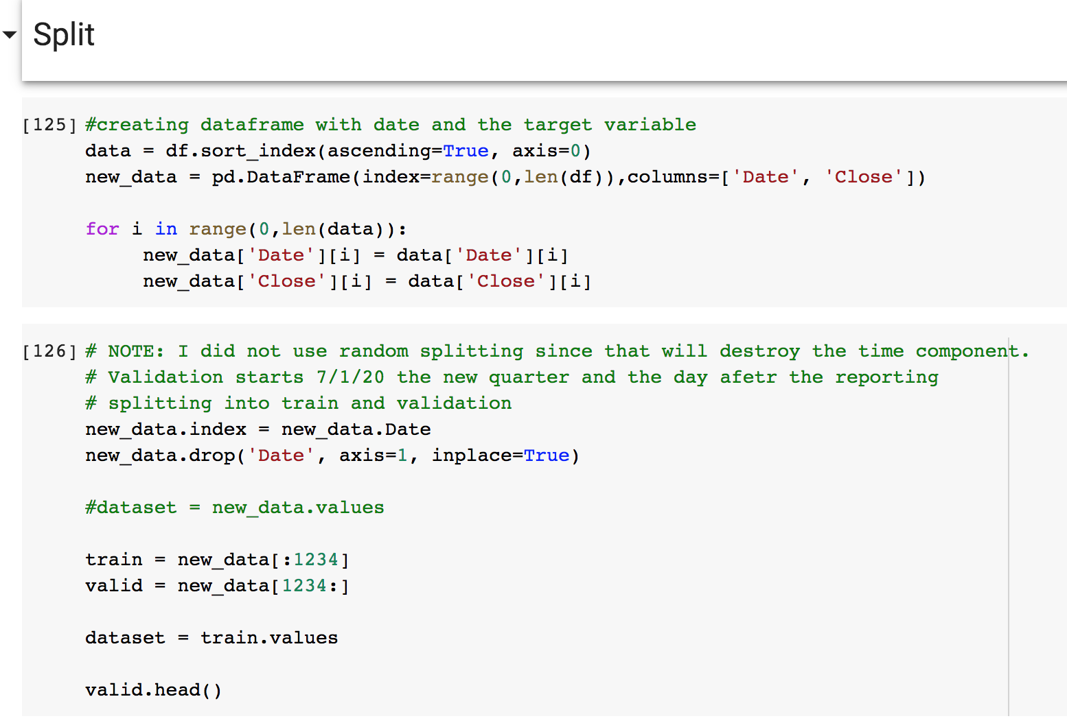
Split Data
Here I am splitting the data
The quarter report technically ends 6/30 so the train data will also end on 6/30
Anything 7/1 and after will be validation

Slide 20
LSTM Steps
First I had to convert/transform the data using a scaler
I then had to split it into x and y to input into LSTM
After research and some trials the best predictions closest to the validation data were using the previous 60 days to train the LSTM
x and y were reduced to last 60 days of quarter
Import neural network functions needed from keras package
Define the LSTM model
Compile then fit the model on formatted training data
Calculate/predict values for the next month

Slide 21
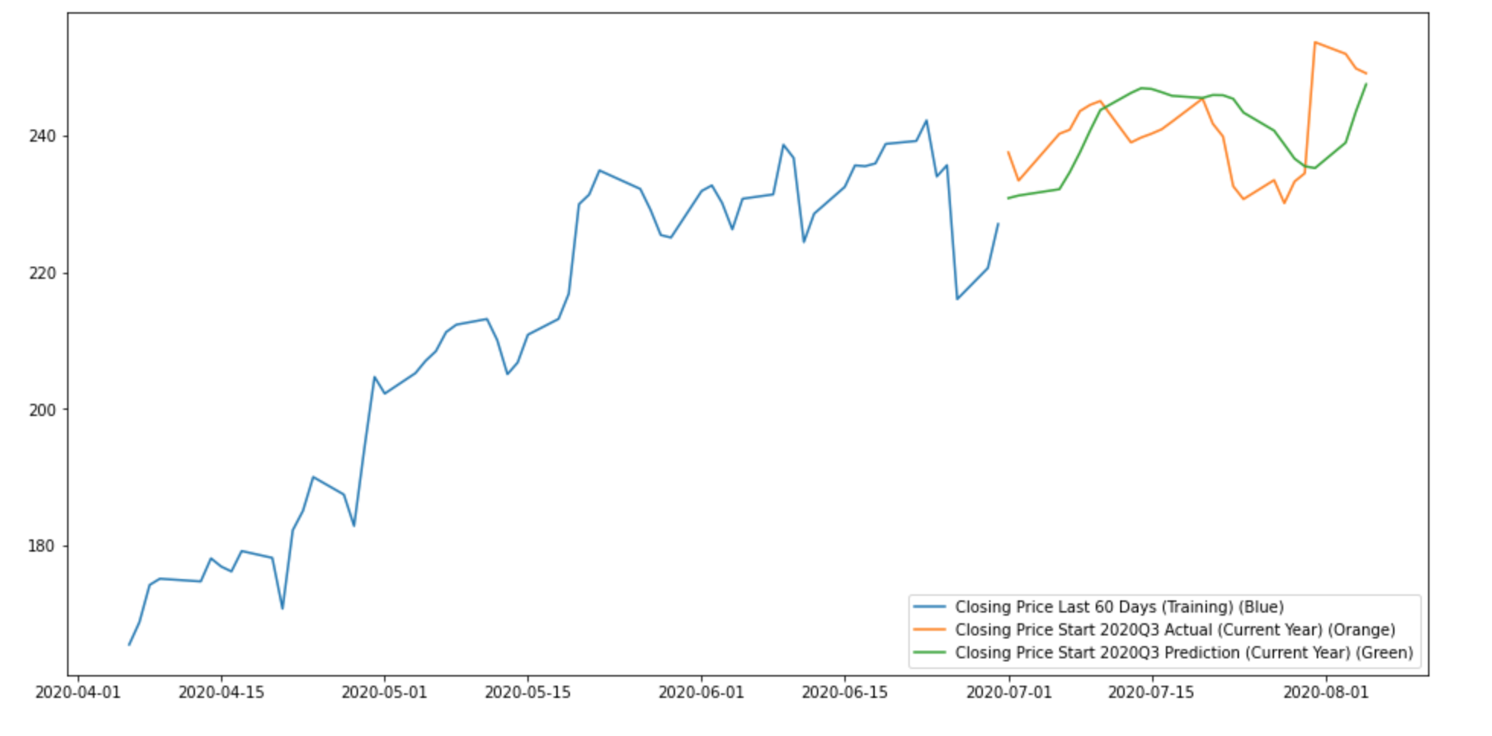
Plotting
The plotting is showing in blue the previous 60 days before the end of the quarter. This was used to train the model. The green is the predicted values from the model and the orange is the actual values from the validation set.

Slide 22
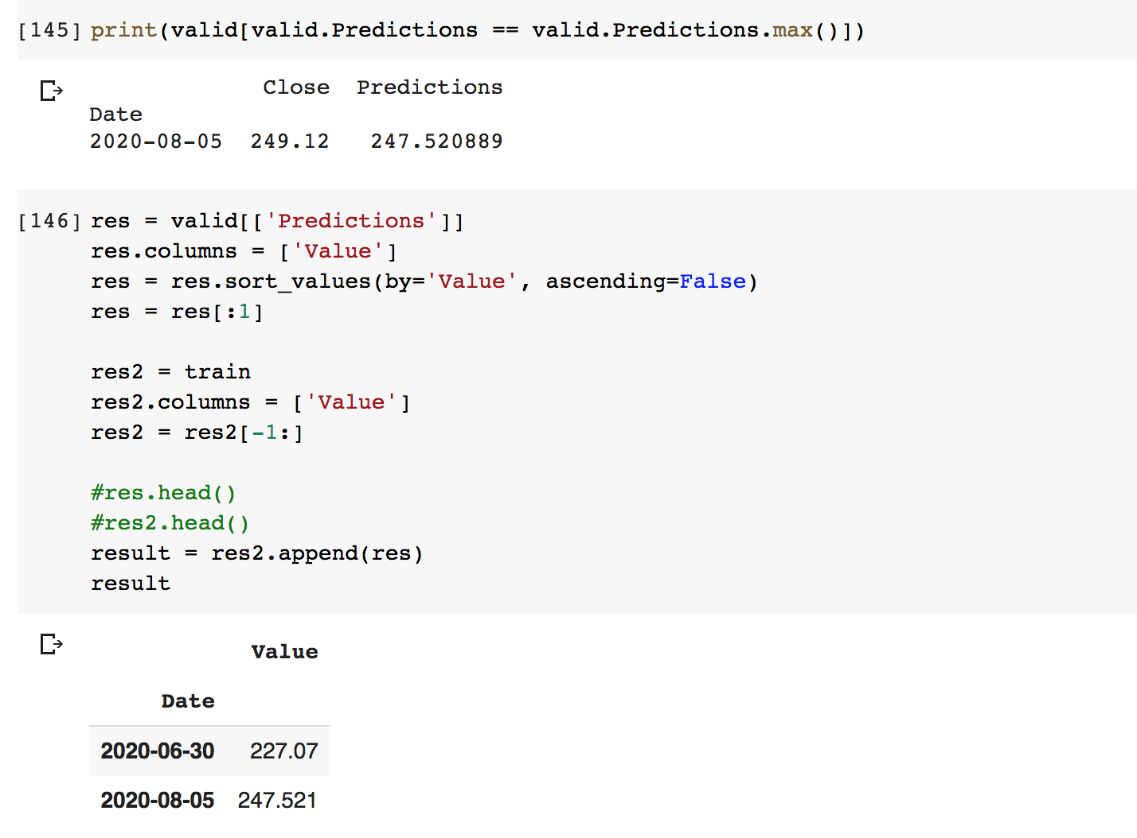
Highest Predicted Price/Sell Date
Normally you sell at the highest value
LSTM is not perfect, but is close
The date that is calculated as the highest is normally +/-3 days from the actual (validation data)

Slide 23
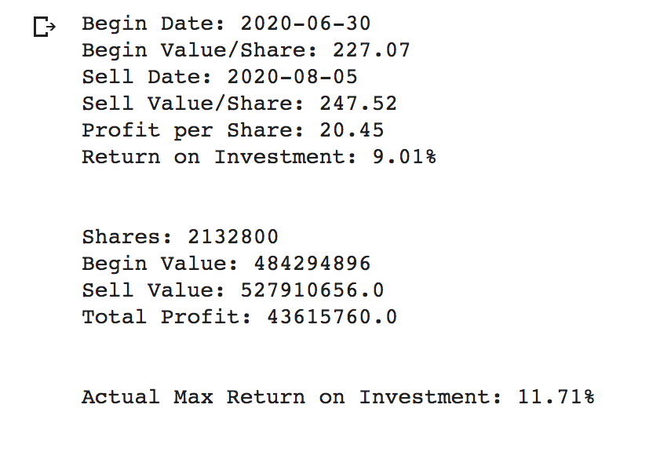
Profit and Investment Return Calculations
These figures are as if the prediction is 100% accurate and you would sell at the highest predicted value
This is to so potential profit from the investment
Can see how close ROI is to actual ROI (validation data)

Slide 24
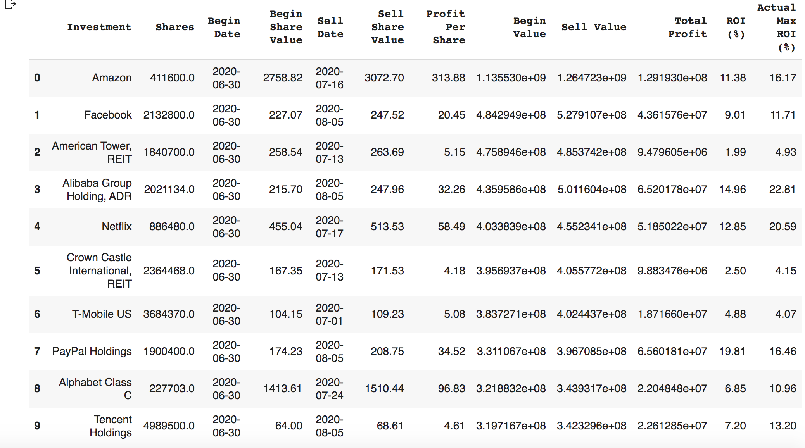
Final Table
This is the final table at the end of all the predictions and can be exported for reports
This can be presented when bringing up possible future investments
The actual values is just to show how accurate the predictions are

Slide 25
Final Steps
The Following Steps were done at the end for the projected/predicted values (1 month in future)
Adding beginning and ending value percent of portfolio
Calculate total sell value (Each high point)
Calculate total portfolio profit
Calculate total portfolio return on investment
Plot return on investment graph
I exported sub-tables along the way through the steps to be able to import to Tableau.

Slide 26
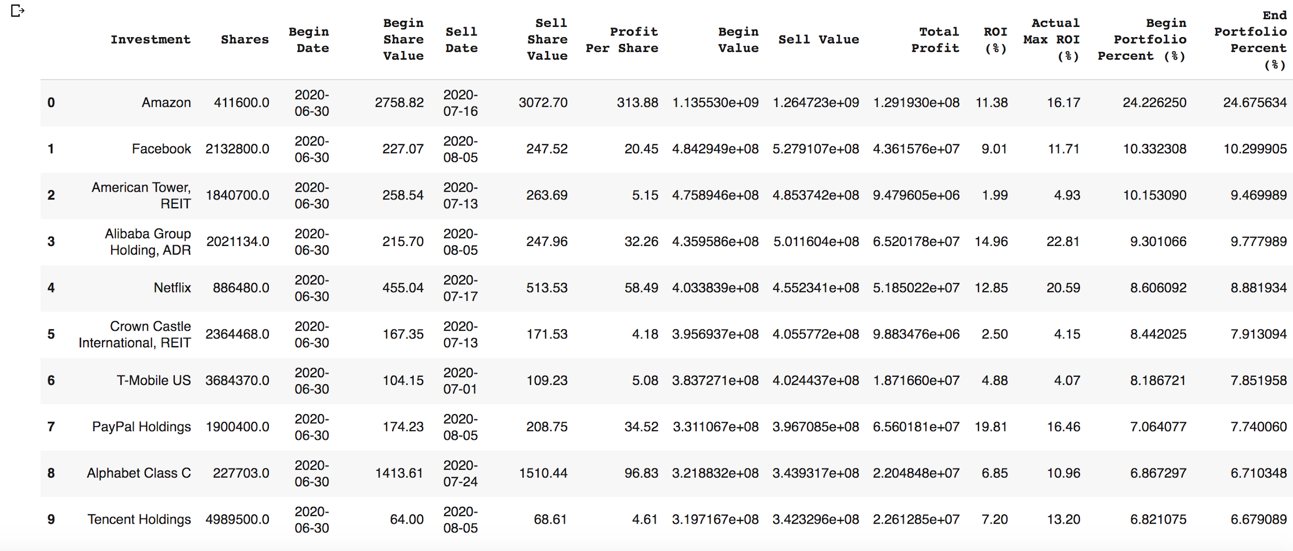
New Final Table
Each Stock’s percent of the portfolio does not change much; Also seen in next slide

Slide 27
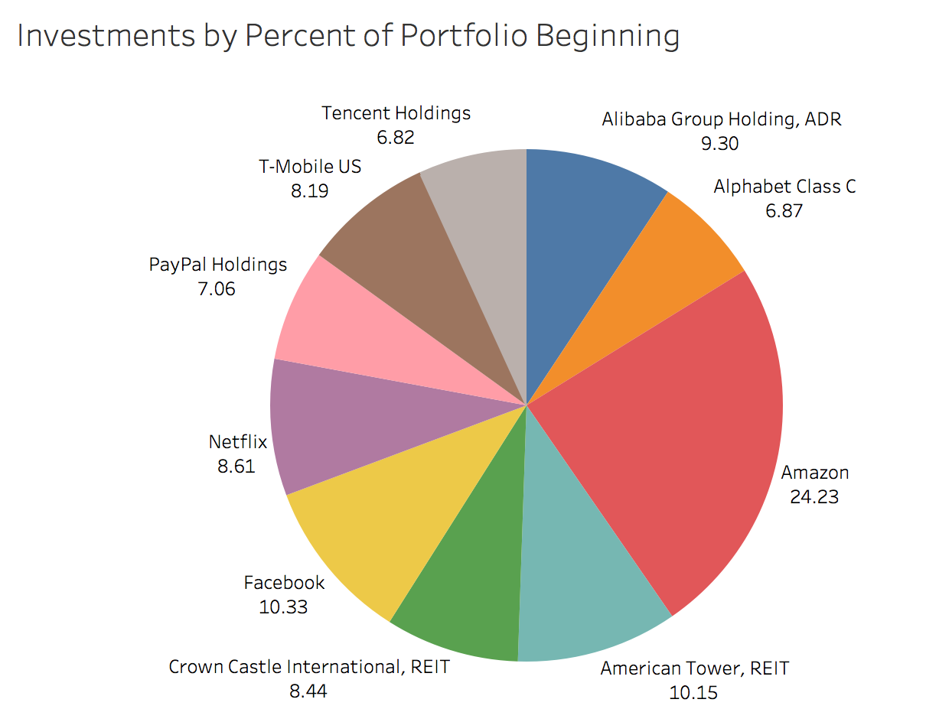
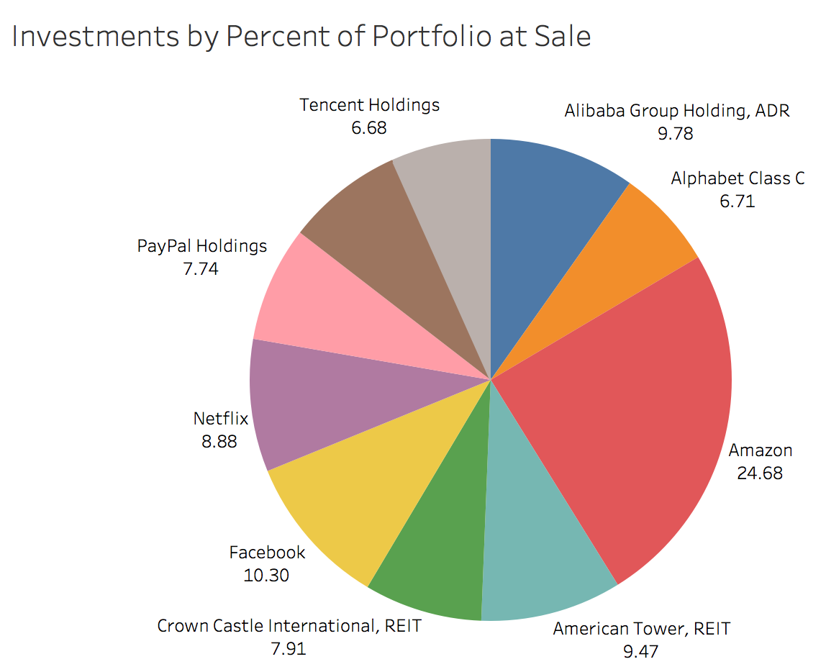
Investments by Percent of Portfolio

Slide 28
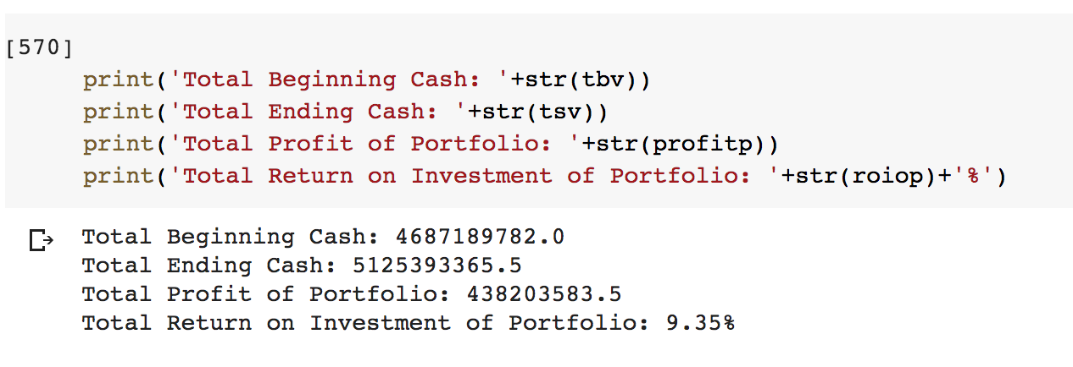
Final Calculations
The ending cash is adding all ending cash from each investment
Profit is ending minus beginning cash
Return on investment is profit divided by beginning cash

Slide 29
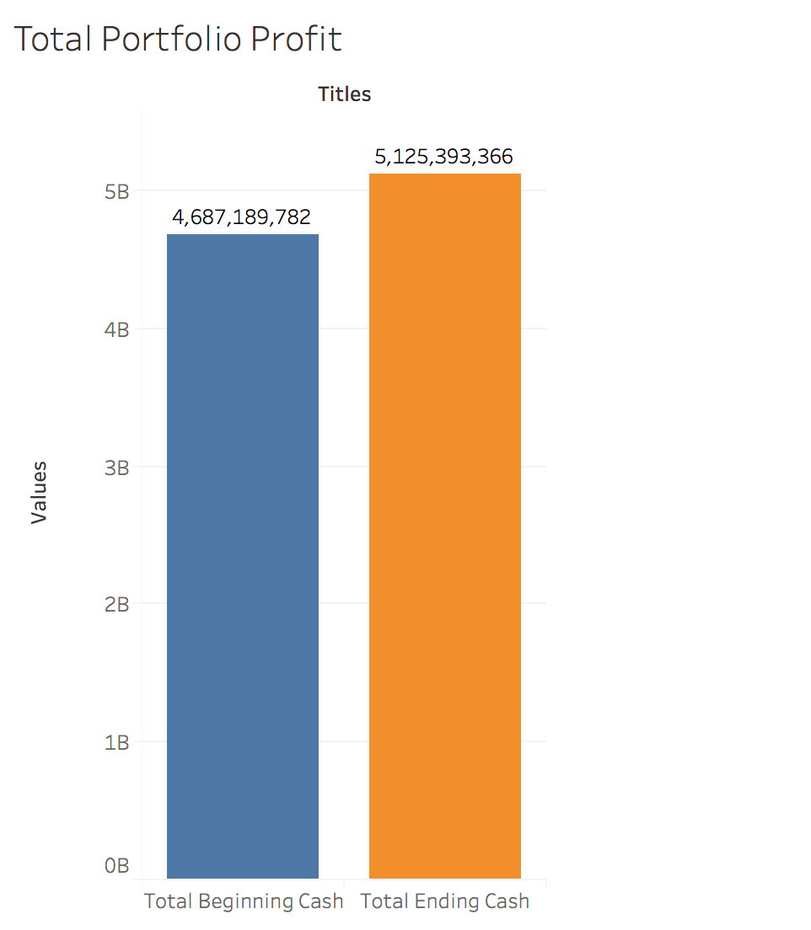
Total Profit
Just like the last profit calculation slide, these figures are just for the entire portfolio:
These figures are as if the prediction is 100% accurate and you would sell at the highest predicted value
This is to so potential profit from the investment
Can see how close ROI is to actual ROI (validation data)

Slide 30
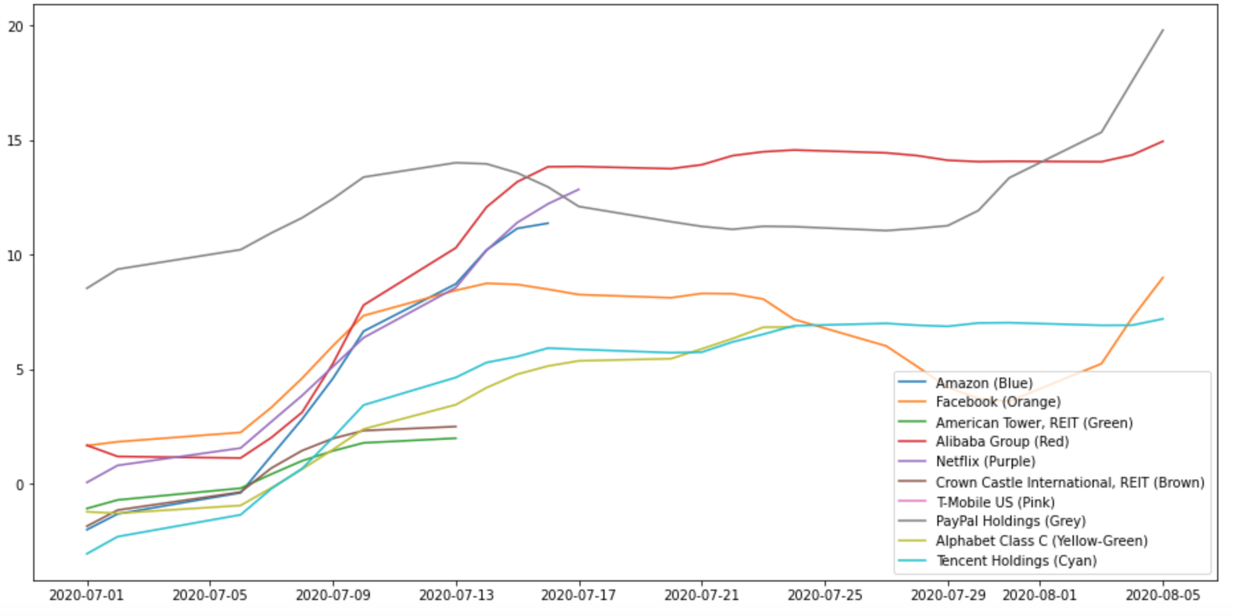
Return on Investment Graph
Line stops at projected end date
Best projected return on investment is Paypal
Facebook, Alibaba, Paypal, and Tencent are highest at the last date (hold not a sell)

Slide 31
Final Projection
The Following graph is similar to what industry professionals would normally present as the predicted return on investments per stock at the end of the projection.

Slide 32
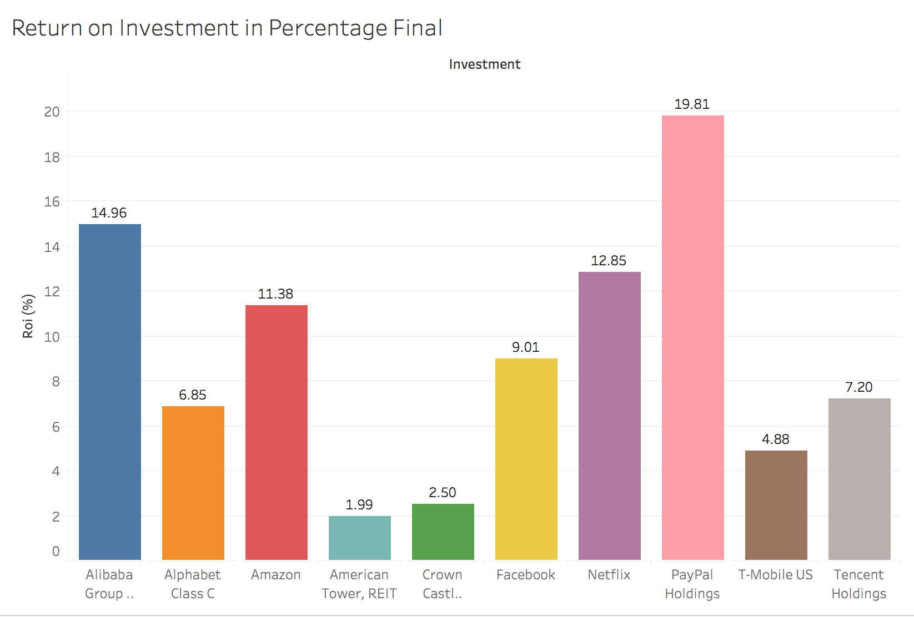
Return on Investment Percent Final

Slide 33
Final Projection
The Following graph compares the previous with the actual return percentages based on the actual data (validation data)
LSTM does catch seasonality and trends better than other models but is not perfect
Does not catch extremes, so return percents are normally lower than actual but the graph shape normally follows the truth. See following time series graphs
The nicer graphs are ones I created in tableau and were created by subtables I exported along the way. It is all automated including Tableau’s ability to link a live connection to a database/file.
These proof of concept that programmed analytics can be used by finance firms and still have nice report grade graphs for executives instead of plain python graphs

Slide 34
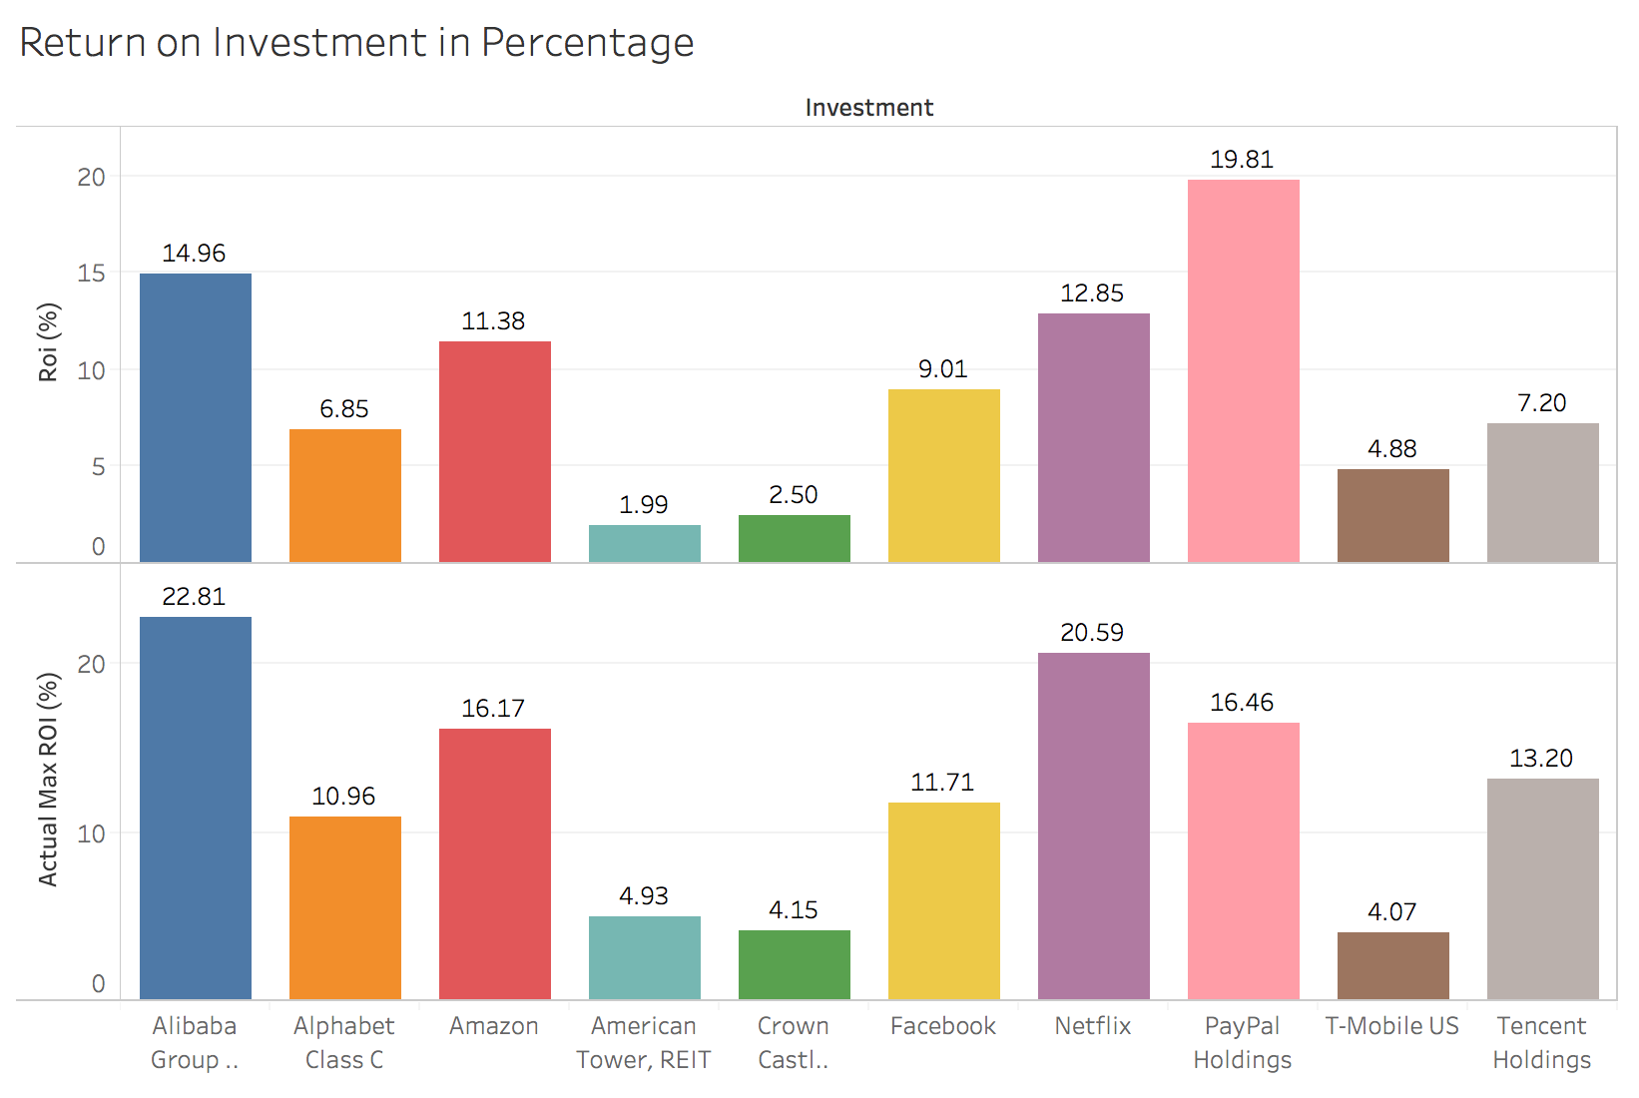
Return on Investment Percent Compared to Actual

Slide 35
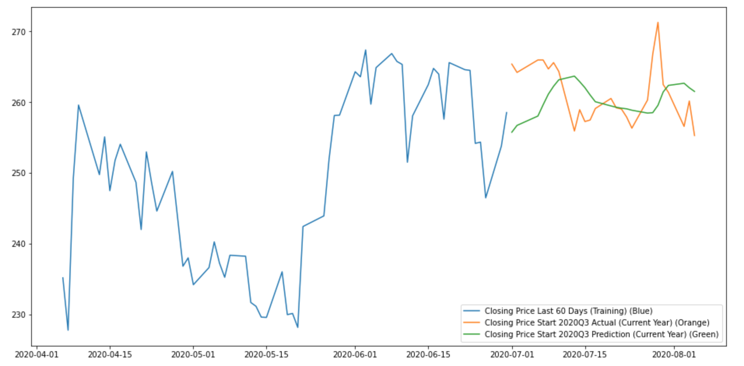
Plotting (AMT)

Slide 36
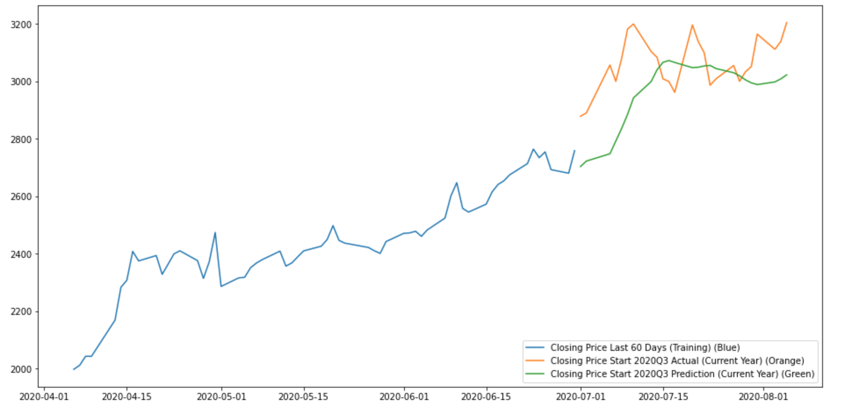
Plotting (AMZN)

Slide 37
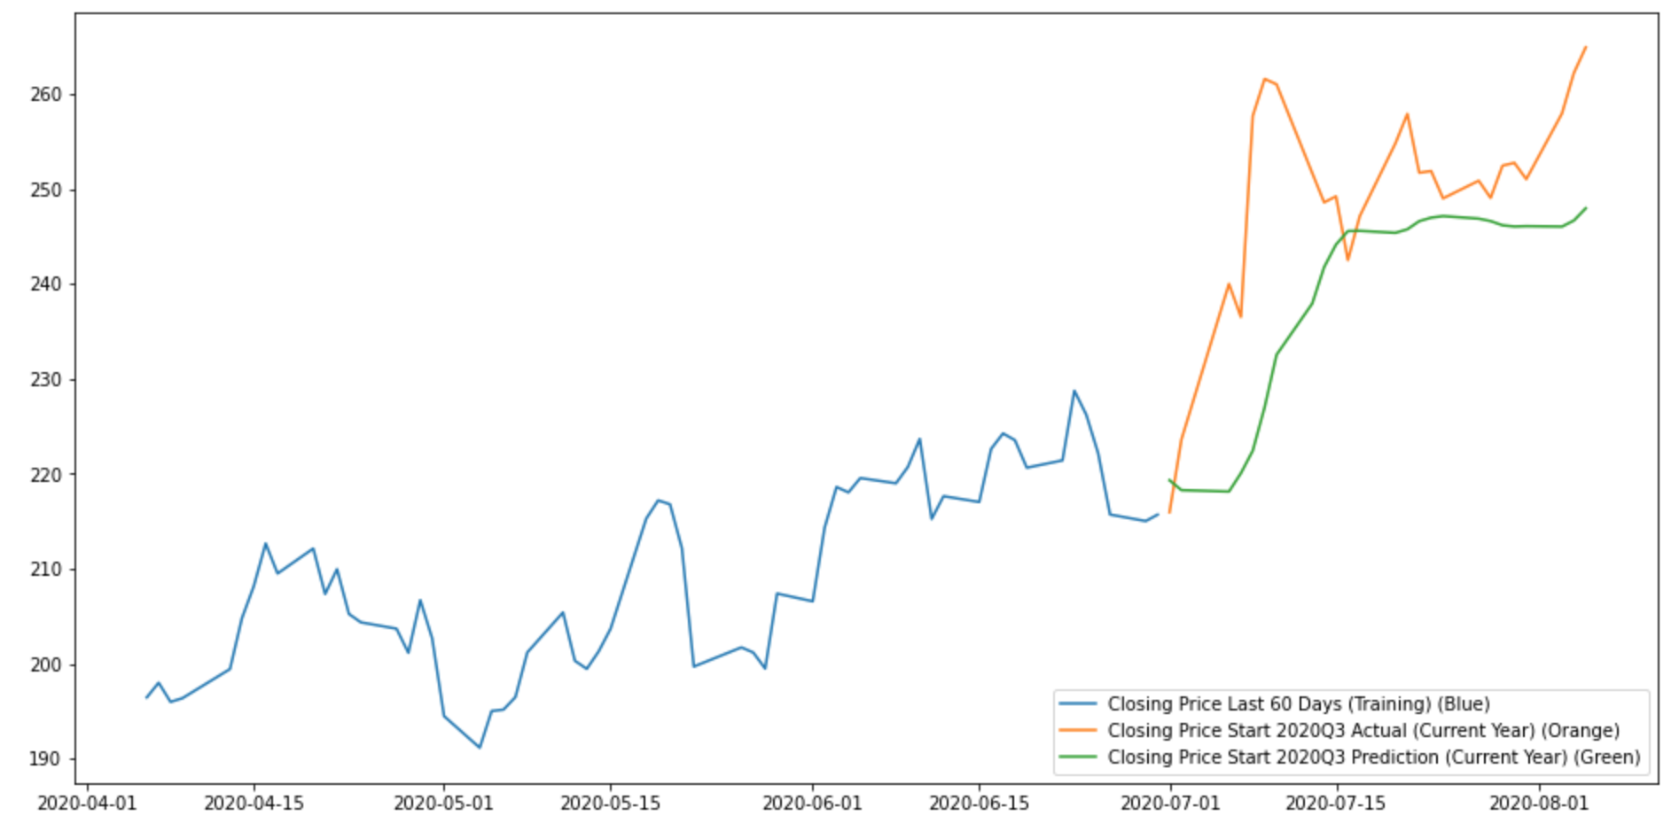
Plotting (BABA)

Slide 38
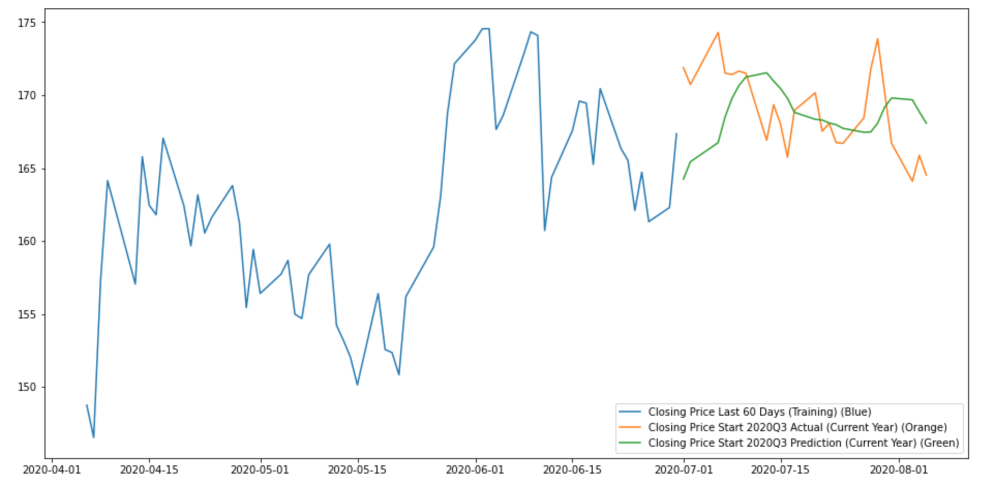
Plotting (CCI)

Slide 39
Plotting (FB)

Slide 40
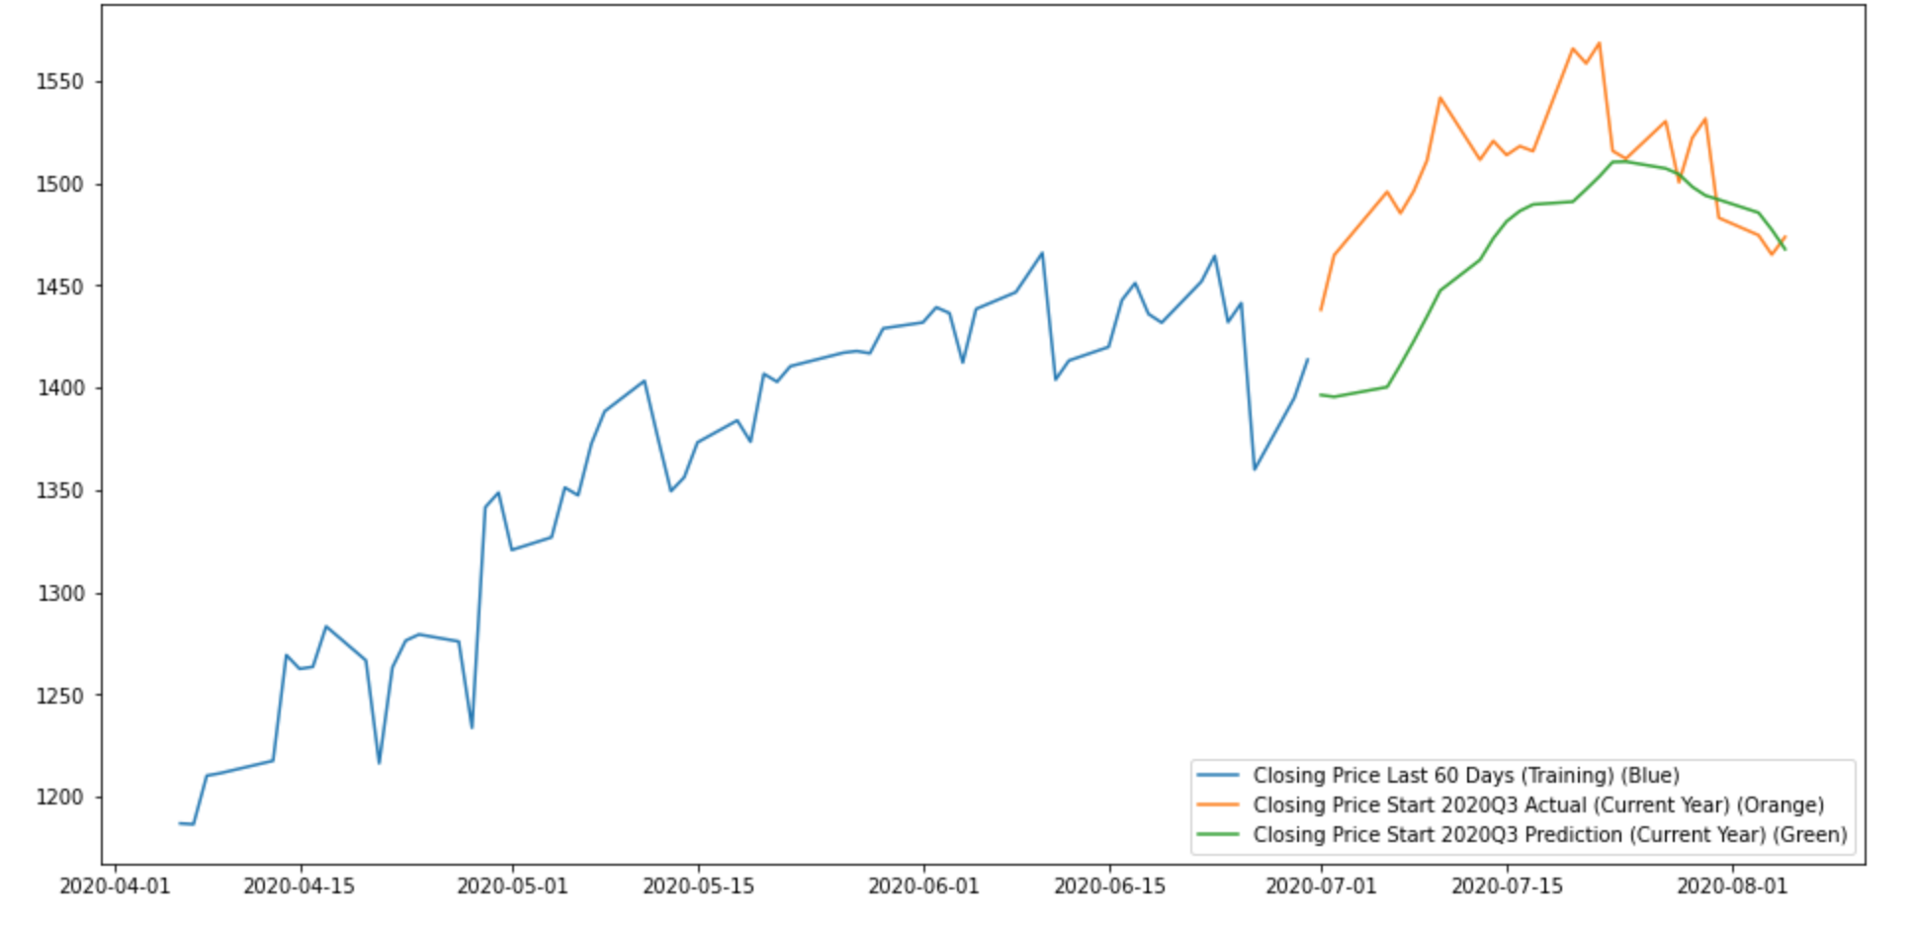
Plotting (GOOG)

Slide 41
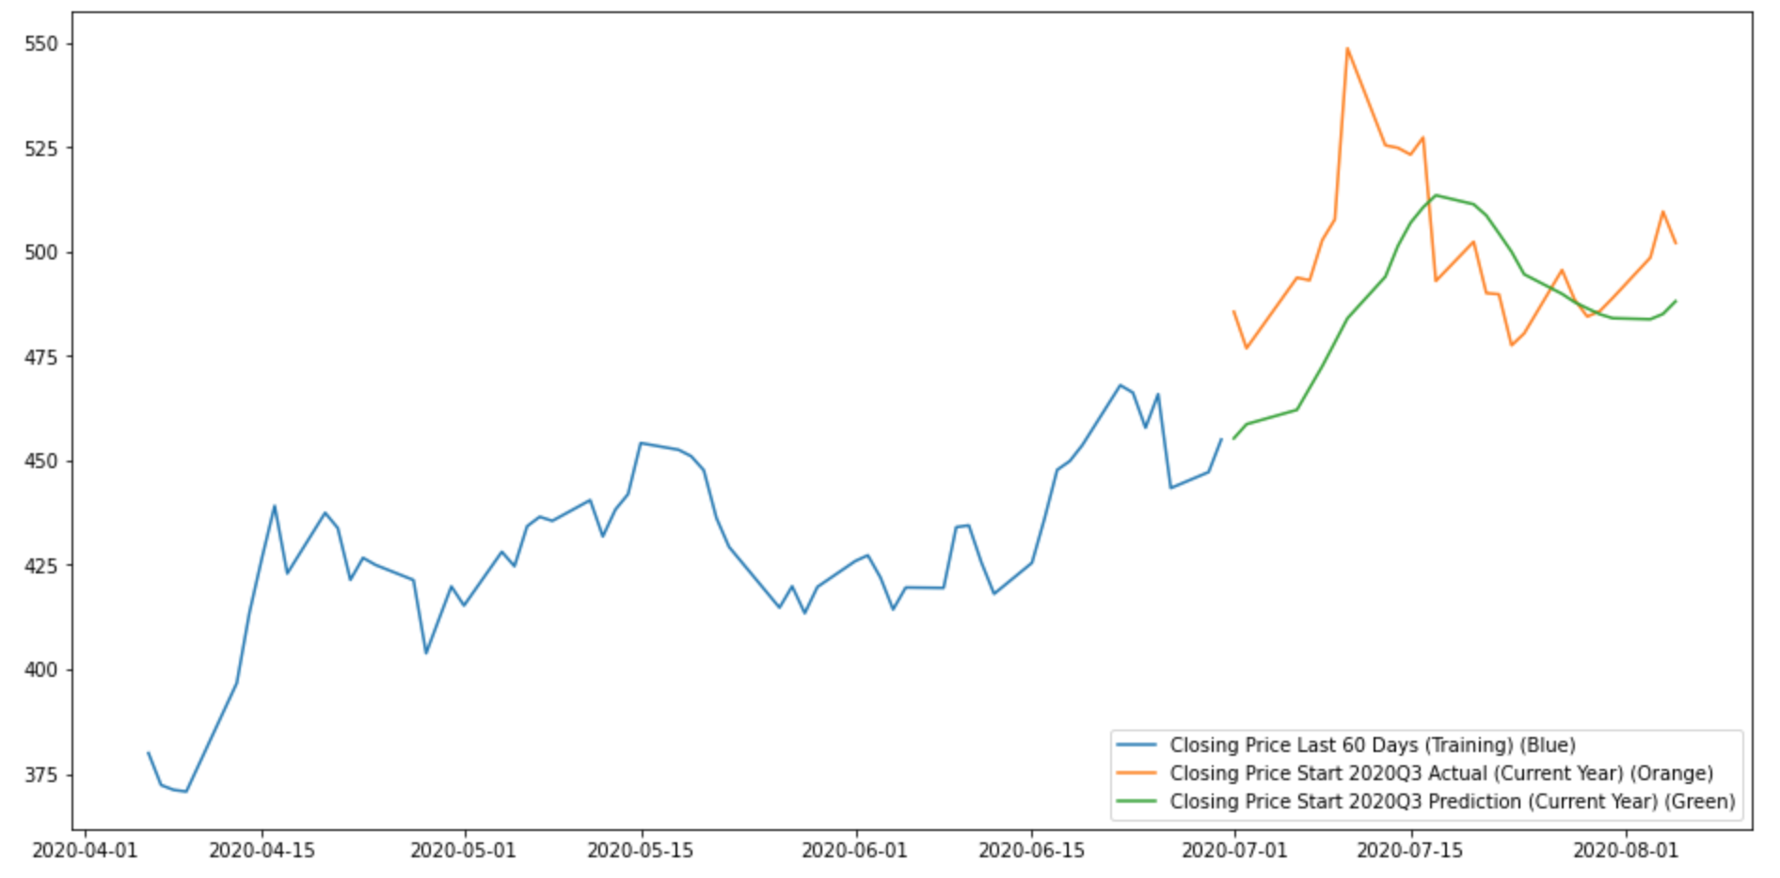
Plotting (NFLX)

Slide 42
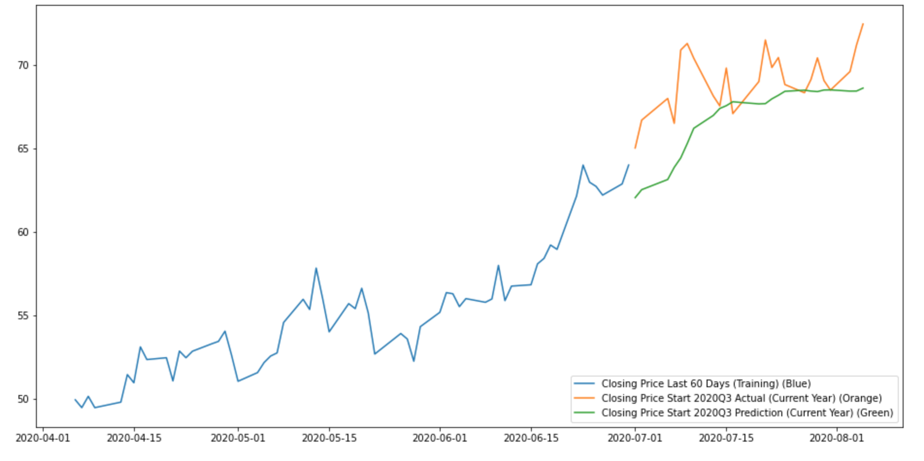
Plotting (TECHY)

Slide 43
Final Comments
As you can see that most of the time the pattern is close to the original
Sometimes the patterns are +/- a week but the pattern is still close to the actual
This can be adjusted for accordingly though in real life applications
The following graphs are occasions that the pattern is still present but projected a little higher than actual
There can be sometimes that the projected is smaller but the patterns holds, it did not occur in my final run through of the project though

Slide 44
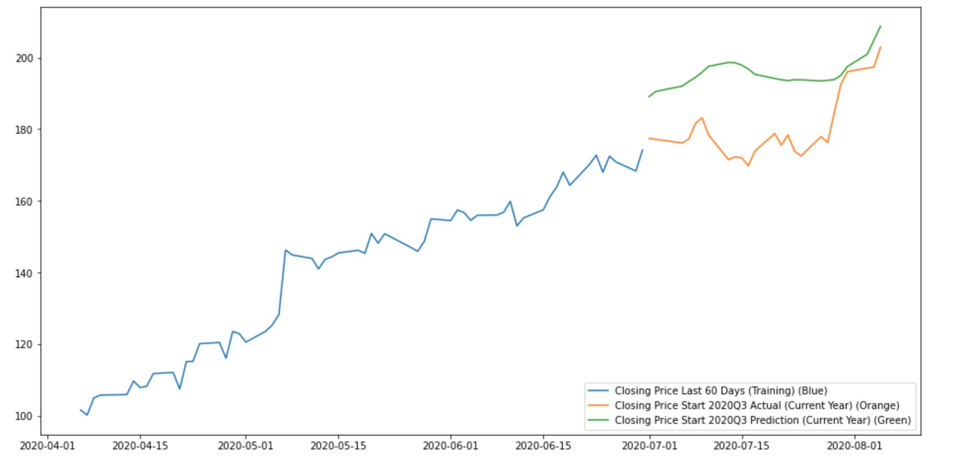
Plotting (PYPL)

Slide 45
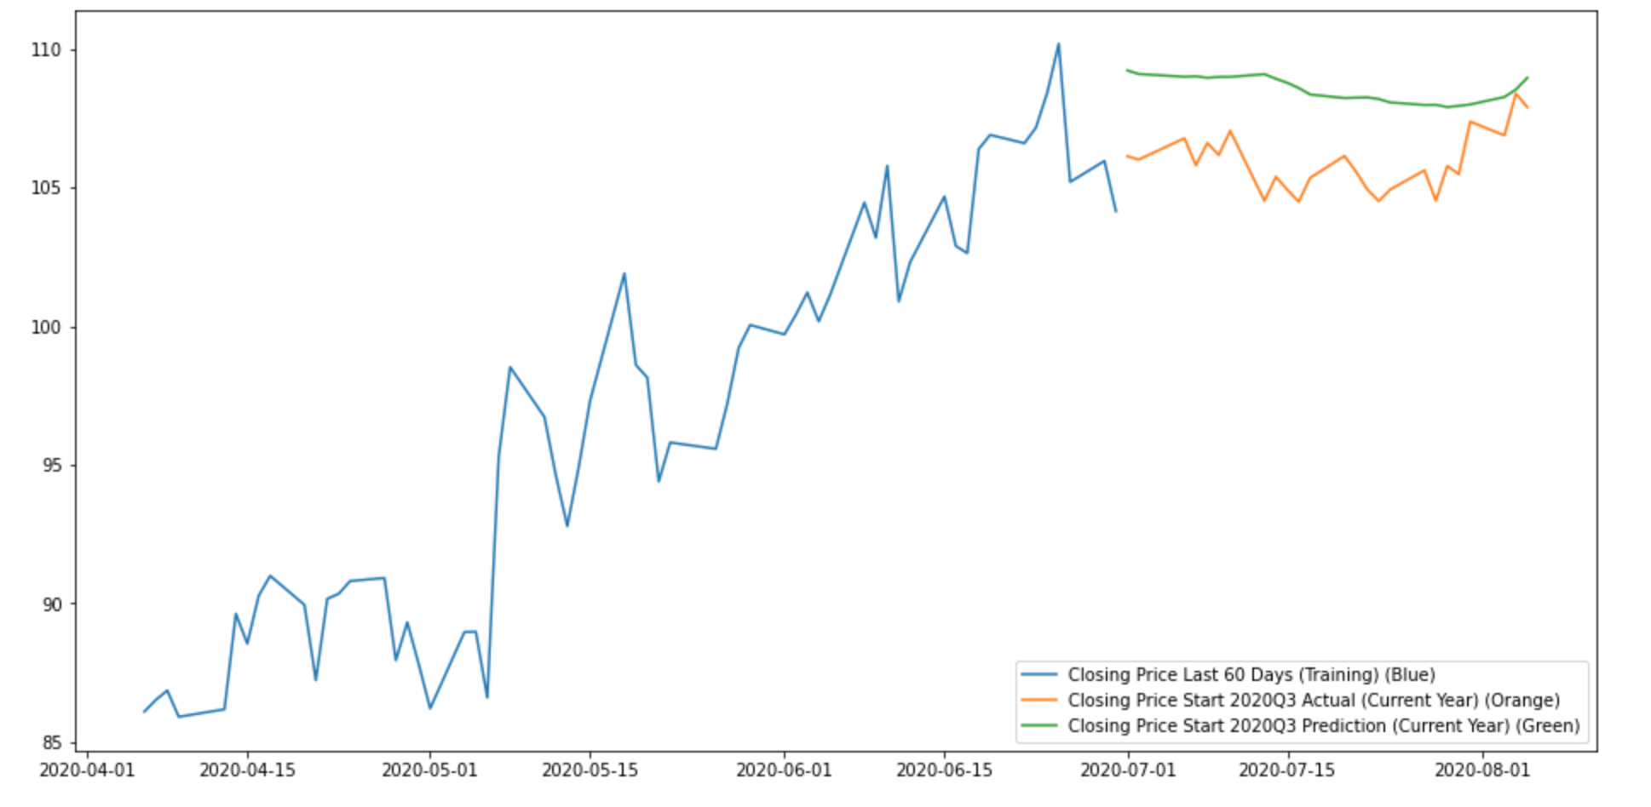
Plotting (TMUS)

Slide 46
Final Comments
LSTM is not perfect, but it is better at predictions than any machine learning so far in the field of finance investments and seriously be considered when companies are choosing what methods they are going to use in investment research.

Slide 47
Questions?

